Slide 1

World travel
Digital Nomad Guide:
The better way to enjoy your world as a nomad

Slide 2
INDEX
INTRODUCTION
ABOUT PROJECT
NAVIGATION BAR
HOVER EFFECT
CONTACT FORM

Slide 3
INTRODUCTION
NAME – MONA SHARMA
COURSE – BACHELOR OF COMPUTER
SECTION – ‘B’
ROLL NO – 229158

Slide 4
ABOUT WEBSITE
MY WEBSITE BASED ON TRAVEL
All About Travel’s prime focus is “leisure traveler”.
We customize complete tour & travel requirements to any destinations in the world, the below list are our recommended destinations.
. UTTRAKHAND
. DESERT, EGYPT

Slide 5



Make a Plan
Set a destination and/or travel theme
1
Set travel dates, mode of travel, and find accommodations
2
Find local attractions, food venues, and activities
3

Slide 6

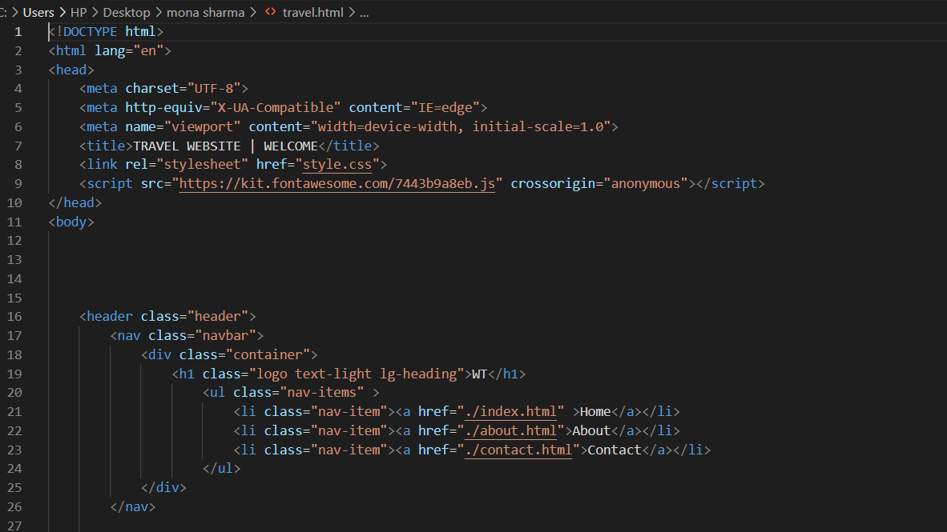
NAVIGATION BAR

Slide 7
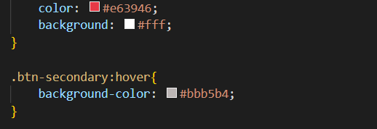
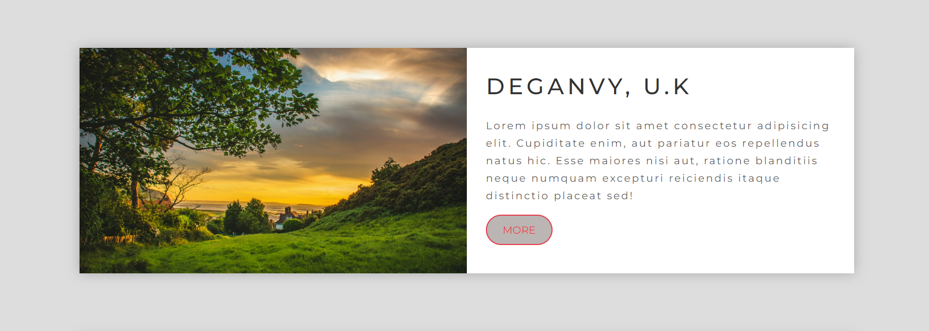
HOVER EFFECT

Slide 8
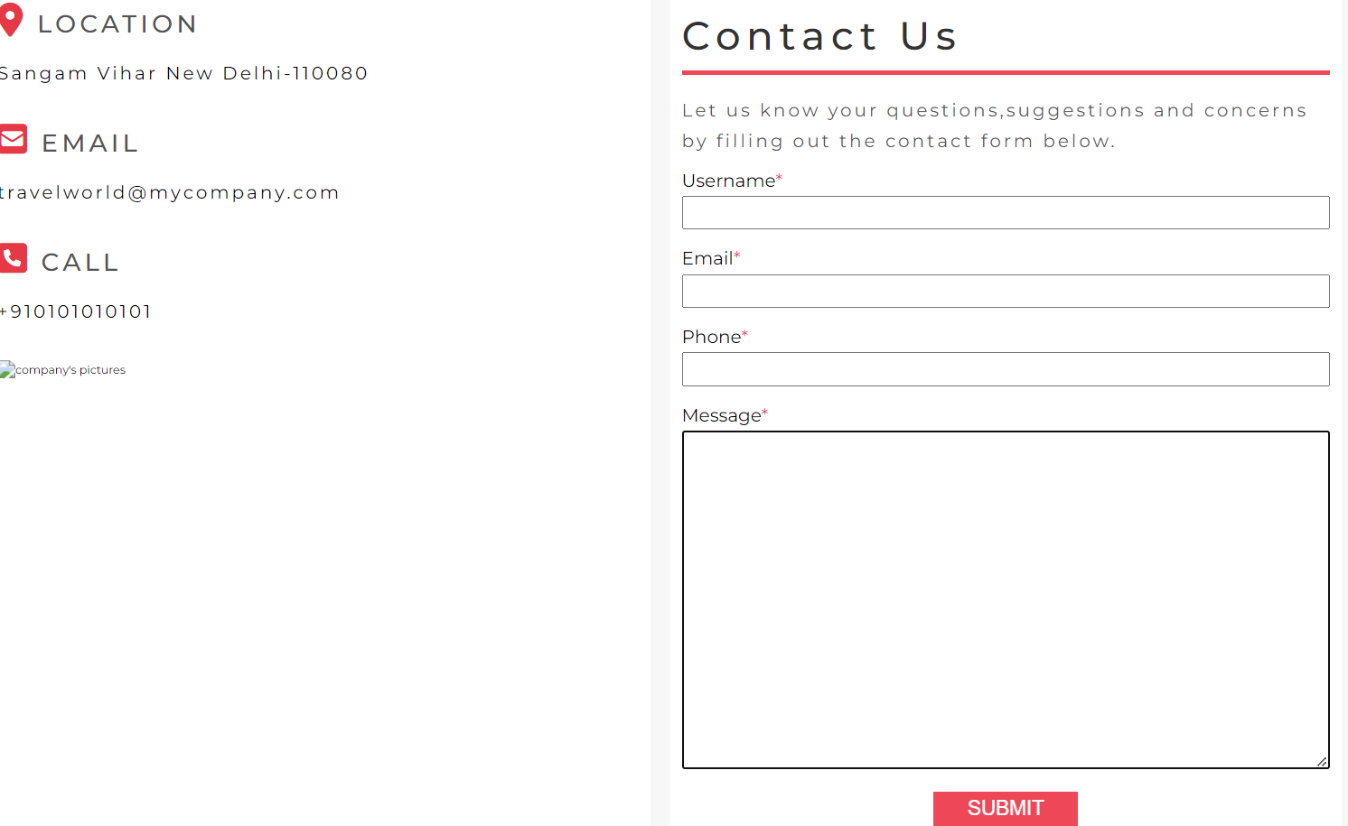
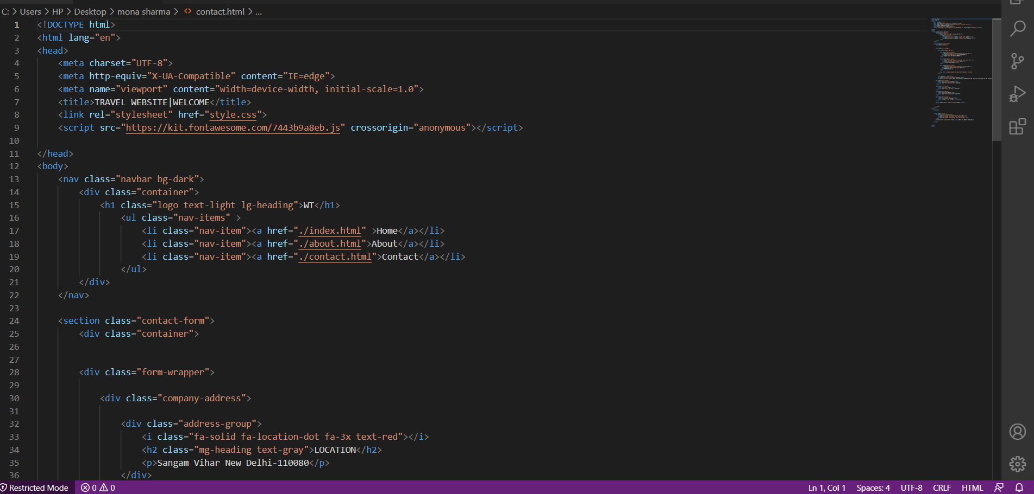
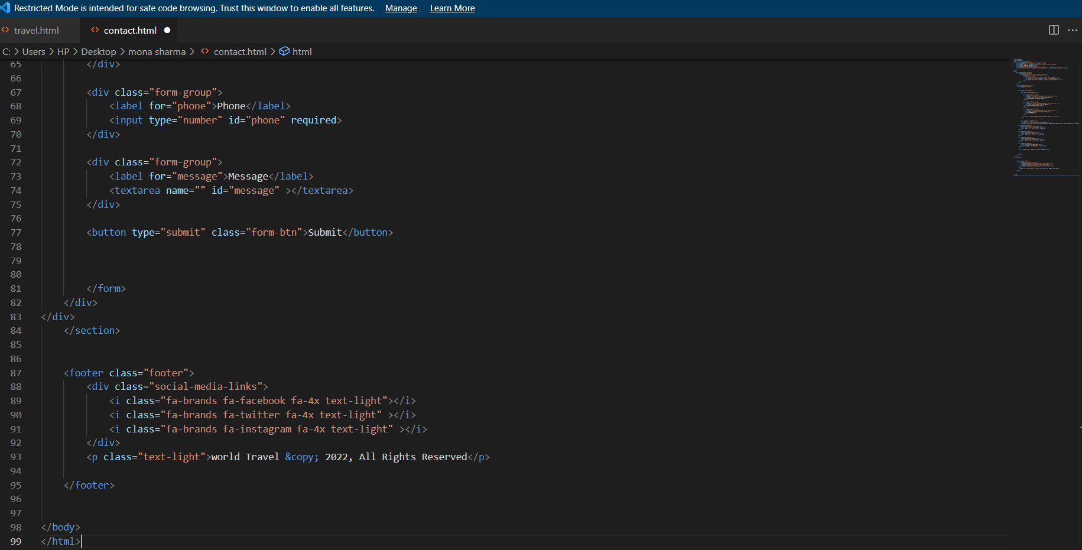
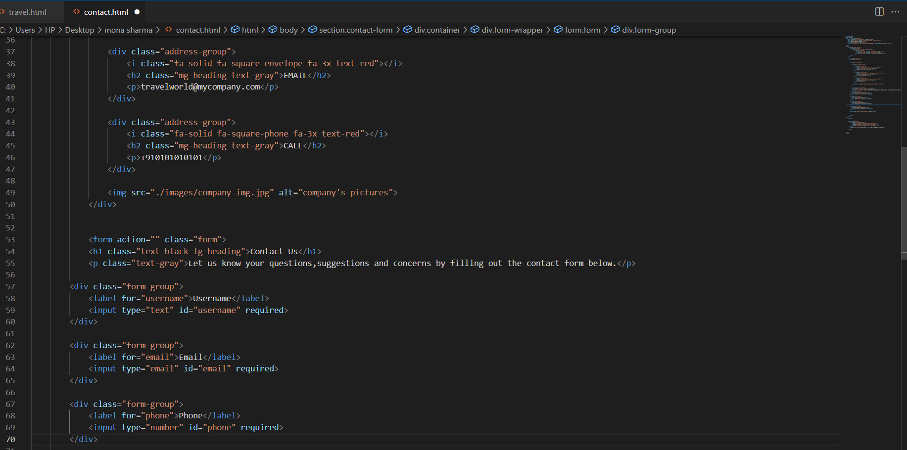
CONTACT FORM

Slide 9
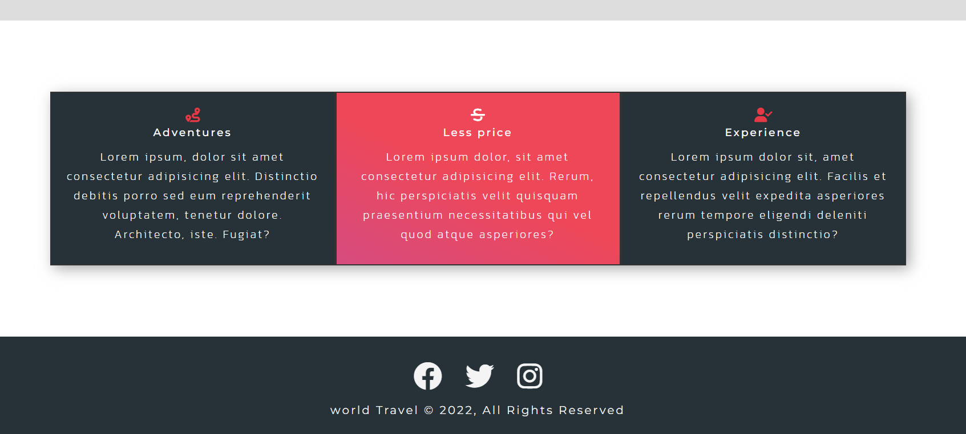
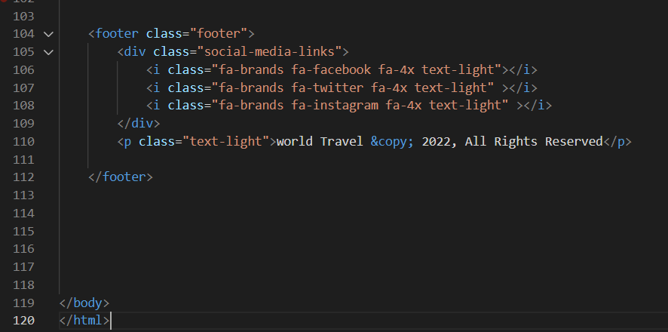
FOOTER

Slide 10

Thank you
someone@example.com

